Slide 1
Comparison between Sinaloa cartels in Mexico and cartels of Colombia
Student’s name
Institution’s name

Slide 2
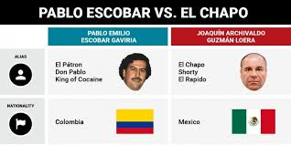
Overview
The Sinaloa cartel in Mexico is a group organization that was founded in 1989 by people such as Palma Salazar and Joaquin Guzman
The organization specializes in criminal activities such as drug trafficking murder, torture, kidnapping and money laundering.
In Mexico, it is the largest drug trafficking group which has corruption connections with the military groups for protection against allegations.
Colombia is one of the nations with high ranks of illegal drug abuse and production.
It has four major groups of cartels who mingle with other criminals to create a social class that is influenced with other aspects such as politics and Columbia culture.
The Columbia government in collaboration with the united states has tried to fight against the drug cartels since the drug barons are very influential and dangerous in marketing and sale of illegal drugs.

Slide 3
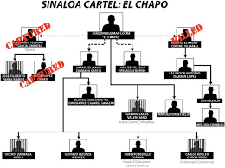
Sinaloa cartels in Mexico
The Sinaloa organization in Mexico is made up of cartels who collaborate in drug trafficking among other criminal activities
Among the major representatives are Ismael zambada, Miguel angle, coroneal villareal and Joaquin guizman (Beittel, 2011).
This cartels specialize in smuggling cocaine which they receive in high quantities from Colombia.
After receiving the drugs from Columbia sources, they distribute them in the united states using means of transport such as trucks, airplanes and boats.
New York city, California and Chicago are the major cells that the cartels smuggle the drugs (Dudley, 2010).
Ismael zambada is the main leader of the Sinaloa cartels and depends on currency shipment in order to ferry drugs between united states and mexico border.

Slide 4
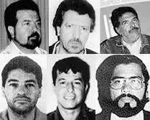
Drug Cartels in Colombia
Colombia is known for its high production of drugs such as cocaine.
Drug trafficking in Colombia started in 1970 and its high demand in united states resulted to growth of cartels (Kenny, 2007).
Pablo escobar is among the main cartels that started drug trafficking in Columbia.
In 1975 he started his cocaine operation that later gained high demand in united states resulting to formation of the Medellin cartels (Kenny, 2007)
The Medellin cartels are groups of wealthy people that were able to bribe the government and acquire weapons for their protection.
Through this cartels, the reign of drug trafficking grew to a point that it was feared to withdraw the government
Studies reveal that 80% of drug trafficking in Columbia is controlled by the Medellin cartels and it is also the largest route of corruption and bribery (Desroches, 2007).

Slide 5
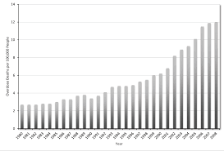
Impacts of the cartel business in the surrounding regions
Following the study from both the Colombia and the Sinaloa cartels in Mexico there are impacts of drug trafficking that have arised and seem to facilitate the growth of the cartels and their illegal businesses
Increased demand for drugs is one of the impacts facilitating growth of cartels . United states is a nation with a higher demand of illegal drugs such as cocaine.
Existence of a ready market for the drugs seems to to be another impact facilitating drug trafficking and growth of cartels .
This is justifiable because in both Mexico and Columbia the growth rate is proportional to the demand
Increased corruption and power for the cartels is another impact that drug trafficking in both countries has elevated. Since it is an illegal activity, the wealthy cartels have decided to bribe government officials for protection and grant for lethal weapons necessary for conducting their operations

Slide 6
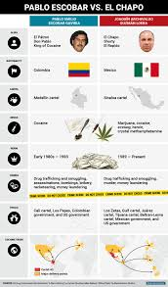
Differences between the cartels in Colombia and the silanoa cartels in Mexico
The silanoa cartels not only engage in drug trafficking but also in other crimes such as murder, kidnapping and money laundering.
On the other hand, the Columbia cartels specialize in drug trafficking and shipment In the united states
Ismael zambada is the main leader of the Sinaloa cartels in Mexico while Pablo Escobar is the leader of the cartels in Columbia
The Sinaloa Mexico cartels not only indulge in drug trafficking but also have a notion of control over national territory
On the other hand, Columbia focuses on drug smuggling and protection of cartels from government regulation

Slide 7
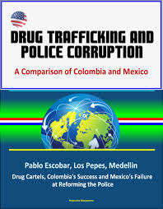
Ties Between Columbia And The Silanoa Mexico Cartels
cartels in both regions have drug trafficking as the main agenda
In both regions the cartels are wealthy and influential
Both mexico and Columbia cartels ship drugs to united states as the main region of consumption
In both regions, drug trafficking has led to increased corruption caused by the cartels as they to cover their illegal deeds
The cartels In both regions have a core leader who started and controls the business.
Both cartels have exposed the world to terror crime and disagreements.

Slide 8
References
Beittel, J. S. (2011). Mexico’s drug trafficking organizations: Source and scope of the rising violence. DIANE Publishing.
Desroches, F. (2007). Research on upper level drug trafficking: a review. Journal of Drug Issues, 37(4), 827-844.
Dudley, S. S. (2010). Drug trafficking organizations in Central America: transportistas, Mexican cartels and maras. Woodrow Wilson International Center for Scholars, Mexico Institute.
Kenney, M. (2007). The architecture of drug trafficking: network forms of organisation in the Colombian cocaine trade. Global crime, 8(3), 233-259.

